Slide 1


Hybrid Knowledge: New Insights in Augmented Intelligence for Human Decision-Making
Dr. Christopher Morse (@christophrmorse)
Senior Expert for Experience Design and Emerging Technologies, Zortify
Dr. Katya Kamlovskaya (@kamlovskaya)
Computational Linguist & Data Scientist, Zortify

Slide 2


ZORTIFY
Our personal writing styles are as unique as our fingerprints. Contained within our writing are valuable insights critical to business success that are invisible to the human eye.
How should your colleagues treat you in order to work successfully with you?

Slide 3
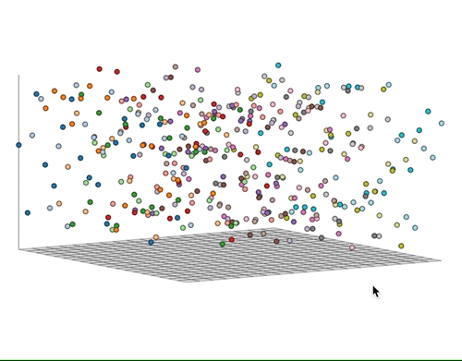
ZORTIFY
Zortify uses natural language processing (NLP) and machine learning techniques to translate written text into contextualized word vectors.

Slide 4

Zortify Select
Dynamic personality analysis across three dimensions: Entrepreneurial Capital, the Big 5, and Destructive Potential.

Slide 5
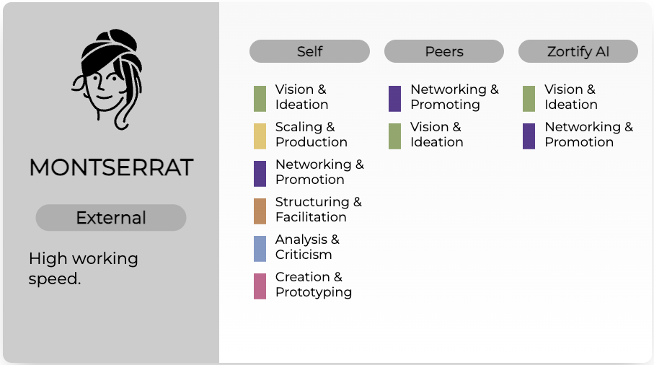
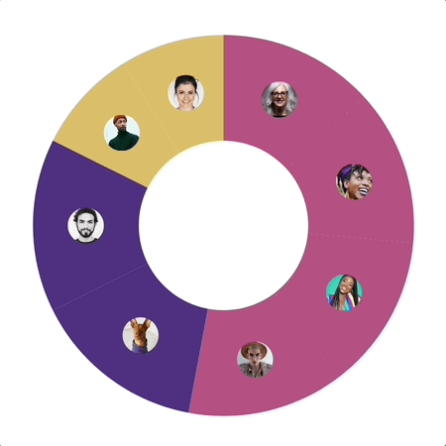
instant High-Performance Teams (iHPT)
Bringing together the right people in the right roles at the right moment.

Slide 6



Interdisciplinary Research Group in Socio-technical Cybersecurity
Cybersecurity threats and defences
Privacy preserving technologies
HCI, deceptive and manipulative technologies
Regulatory compliance and digital ethics

Slide 7





« Augmented intelligence »
.
Lawyer (medical law / biotechnology law) 1999 – 2019
PhD in Biotechnology Law 2017
Postdoctoral Researcher (UKZN) 2019 – 2021
Postdoctoral researcher (UL) 2021 – current
Research interests
Biotechnology Law – genetics/genomics, stem cell research
Data governance – sharing, ownership, intellectual property
Digital behavioural manipulation – autonomy, identity
Digital medicine – digital recruiting regulation and ethics
Cybersecurity – research ethics and protection of researchers
Digital Ethics - Special issue on Digital Ethics (HSSC Journal)

Slide 8
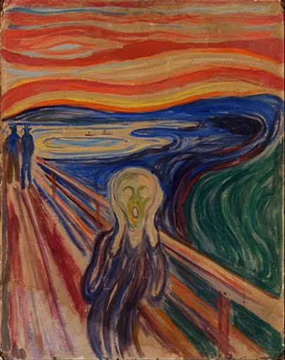
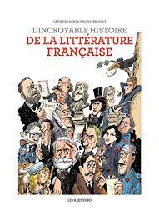


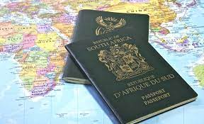
« Human decision making »
.
Literature
Wine
Music
Travel
Art inspired poetry

Slide 9

.
maria.botes@uni.lu
.

